Slide 1
A4: Concept Video
Kristine Ma, Carolyn Lee, Lucas Wang, Evelyn Song
CS147 ✳ Fall 2024

Slide 2
Table of contents
01
02
03
Market research
Project name & value proposition
Problem/solution overview
Team intros, project name reveal + value proposition
Introducing problem, how our app solves this
Existing solutions, competitor analysis
04
Values in design
05
Task breakdown
06
Video storyboards
Direct/indirect stakeholders, ethical implications
Simple, moderate, complex tasks
Storyboard images, video demonstration

Slide 3
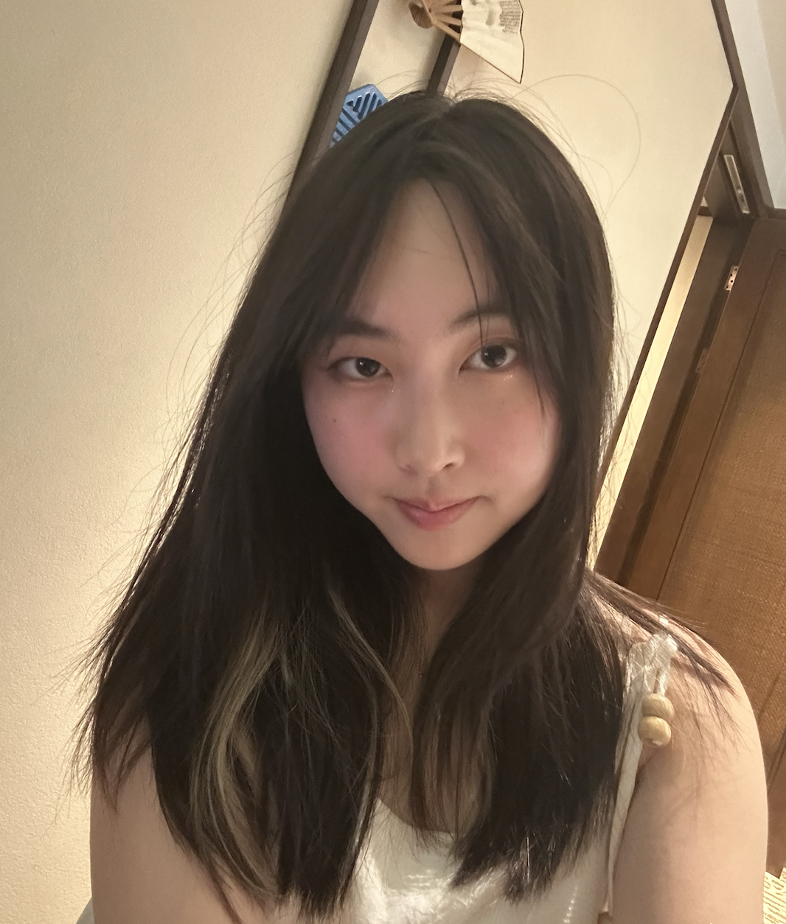

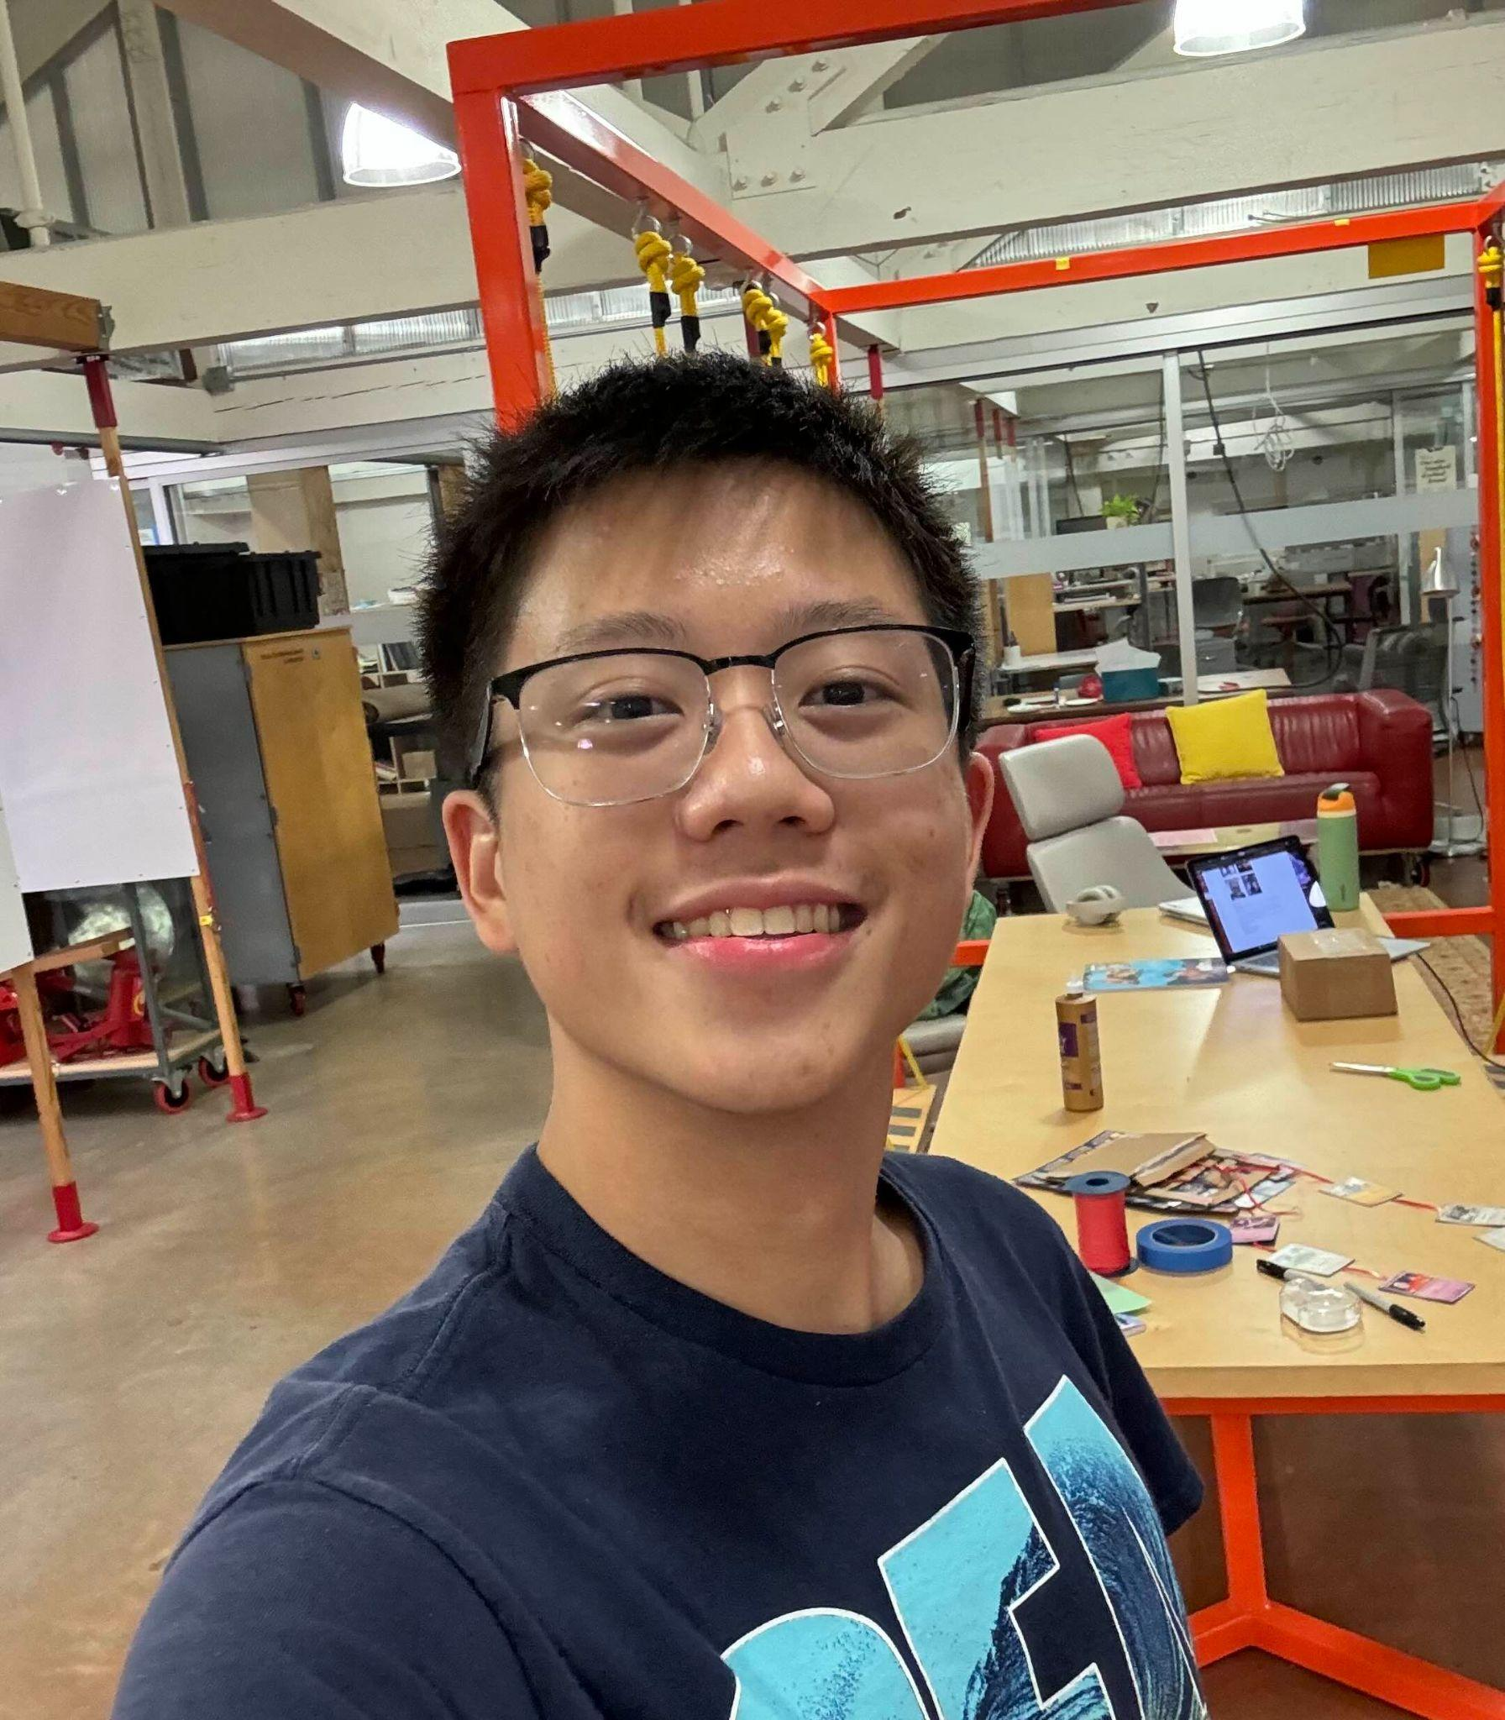

Meet the team!
Kristine Ma
Carolyn Lee
Lucas Wang
Evelyn Song
Junior
Symbolic Systems (HCI)
Junior
Computer Science (HCI)
Sophomore
Design +
CS (HCI)
Junior
Human Biology + CS (HCI)

Slide 4
Project Name
InSync
Lync
Pasynco
Planet 🪐
Wink
Synchole
CheckIn
OYM (on your mind)

Slide 5
Planet 🪐
We wanted a name and a concept that would allow us to capture our problem space and solution. According to our needfinding interviews, most interviewees revealed that friends are their main source of support, but that it’s difficult to connect or to spend time with them. Planet allows its users to deal with alienation and the feeling that friends are living in different worlds.

Slide 6
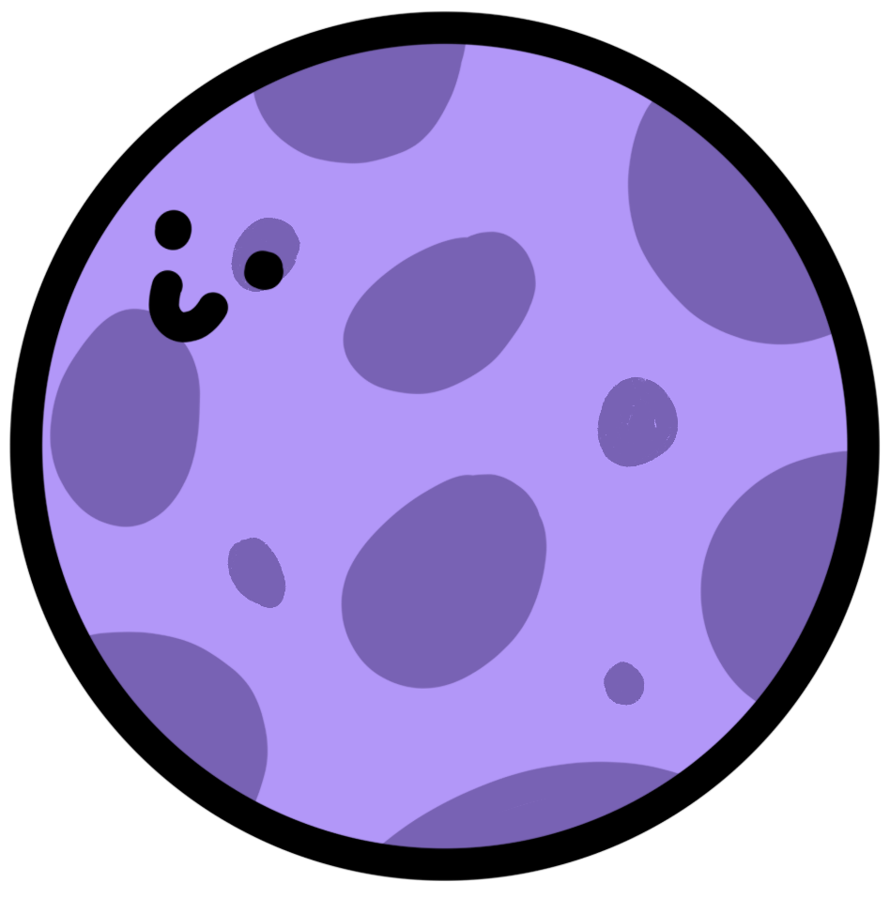
Our value proposition
“Planet lets you visually connect with your friends' emotions and statuses in real-time, so you never feel alienated and always know who's able to hang out or needs companionship..”

Slide 7
Problem Overview
Primary User
Problem We’re Tackling
College students with existing friend groups but who find it difficult to reach out and connect, especially during periods of negative emotion
Reaching out to friends is seen as time consuming and an inconvenience to the other person, and is especially difficult to do when in a bad headspace, leading to isolation

Slide 8
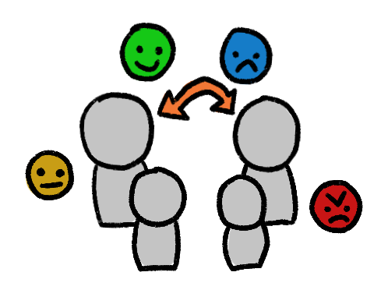
Proposed Solution
Update friends on the current moods of other friends, reducing the awkwardness of talking about emotions directly

Slide 9

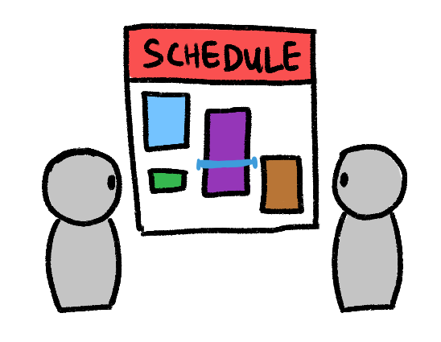
Proposed Solution
Update friends on the current moods of other friends, reducing the awkwardness of talking about emotions directly
Allow friends to easily see busy times on each others’ schedules without back-and-forth hassle

Slide 10
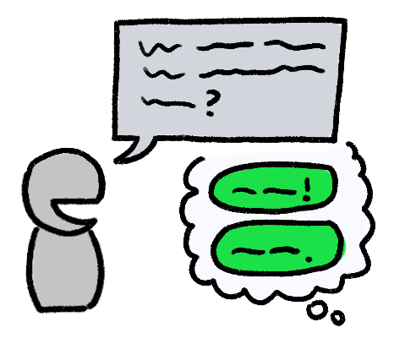
Proposed Solution
Update friends on the current moods of other friends, reducing the awkwardness of talking about emotions directly
Allow friends to easily see busy times on each others’ schedules without back-and-forth hassle
Help friends engage with each other quickly and easily via reactions to posted emotions / statuses

Slide 11

Market Research: BeReal
Real-time photo sharing showing what your friend is doing at a given moment.
What works for our problem space:
Significant visual component: a photo capturing front + rear camera perspectives
Fostering authenticity and connection via notifications to share statuses
What doesn’t work:
Can only post limited amount of statuses in a day
Doesn’t share emotions of users
Not geared towards helping friends start a conversation / plan hangouts
[image here]
“Your daily dose of real life.”

Slide 12

Market Research: Life360
Family safety app connecting people via location-sharing, notifications, and life alerts.
What works for our problem space:
Location sharing fosters long-distance connections
Regular updates in background keep users informed of locations
Limited reactions (“Be safe!” “Love ya!”)
What doesn’t work:
Designed to focus on family safety, not necessarily connections with friends
Similar to BeReal, also doesn’t have an emotion component component, and also doesn’t facilitate conversation
[image here]
“Peace of mind starts here.”

Slide 13

Market Research: Locket
Widget-based app that lets users share live photos directly to each other's home screens.
What works for our problem space:
Accessibility of update (widget format)
Focus on close friends
Updating pictures and sharing with friends
What doesn’t work:
Only based on widget, no complex features
Like our other competitors, no emotional component, no encouragement of planning socialization
[image here]
“Live pics from best friends.”

Slide 14

Market Research: YikYak
Anonymous social media app that connects college students with others in their area.
What works for our problem space:
Location-based interactions encourage engagement with nearby people
What doesn’t work:
Anonymous posts don’t support personal connections
Doesn’t allow people to connect with their established friends
[image here]
"Find your herd."

Slide 15

Market Research: FindMy
An Apple-developed app that helps users track their devices and share locations.
What works for our problem space:
Real-time location sharing helps coordinate hangouts.
What doesn’t work:
Very limited information
Only location, no knowledge of friend’s activities
Only support iOS users
No ability to engage / interact with friends
No emotional component
[image here]

Slide 16


🪐
Emotional aspect
Supports photo status
Status update
Persistent / supports multiple updates
Supports reactions / engagement between users

Slide 17
Stakeholders
Direct stakeholders
College students struggling with connecting with friends
Indirect stakeholders
Universities and institutions interested in improving student mental health
Friends and family of users
🪐

Slide 18
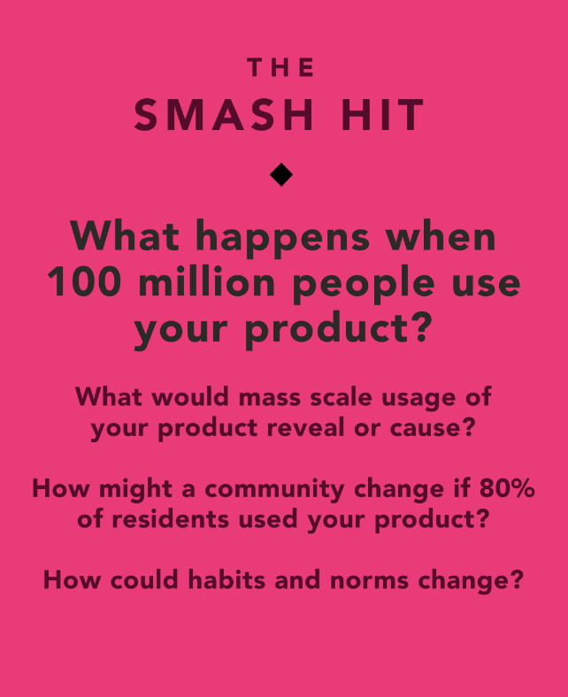
Ethical Implications
Ethical Implication: Stalking Behavior
Solution: Blocklist/removal from friend list
Direct Stakeholders: Users concerned about privacy
Indirect Stakeholders: Developers, advertisers, parents, regulators
Value Tension: Connection vs. privacy
Design Fixes: Enhanced privacy controls (blocklist, custom visibility)

Slide 19
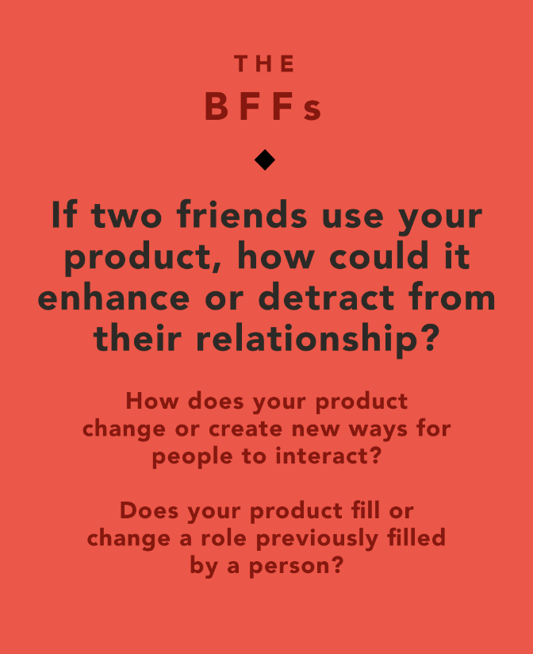
Ethical Implications
Ethical Implication: Oversimplification of Emotions & Reducing Authenticity
Solution: Encourage users to take things offline; interpret the status as a sneak peak, not the full picture
Direct Stakeholders: Users who are friends
Indirect Stakeholders: Family members who may feel excluded from automated communication & mental health professionals concerned about the app reducing the quality of emotional sharing
Value Tension: Convenience vs. authenticity
Design Fixes: Add reminders for users to check in directly with friends (e.g., voice or video calls)

Slide 20
Tasks
Simple | Moderate | Complex
Allow the app to access your preferred calendar app and share it with friends (01:02) | Set up or update your own status and emotions to notify friends about your availability and feelings in real-time (0:44) Take photos of your current surroundings / tasks | Link the app with iMessage / preferred texting app so that you can add a button that automatically takes you to that platform (0:57) Customize the visibility of your status and emotion updates for specific groups of friends, enabling more privacy controls

Slide 21
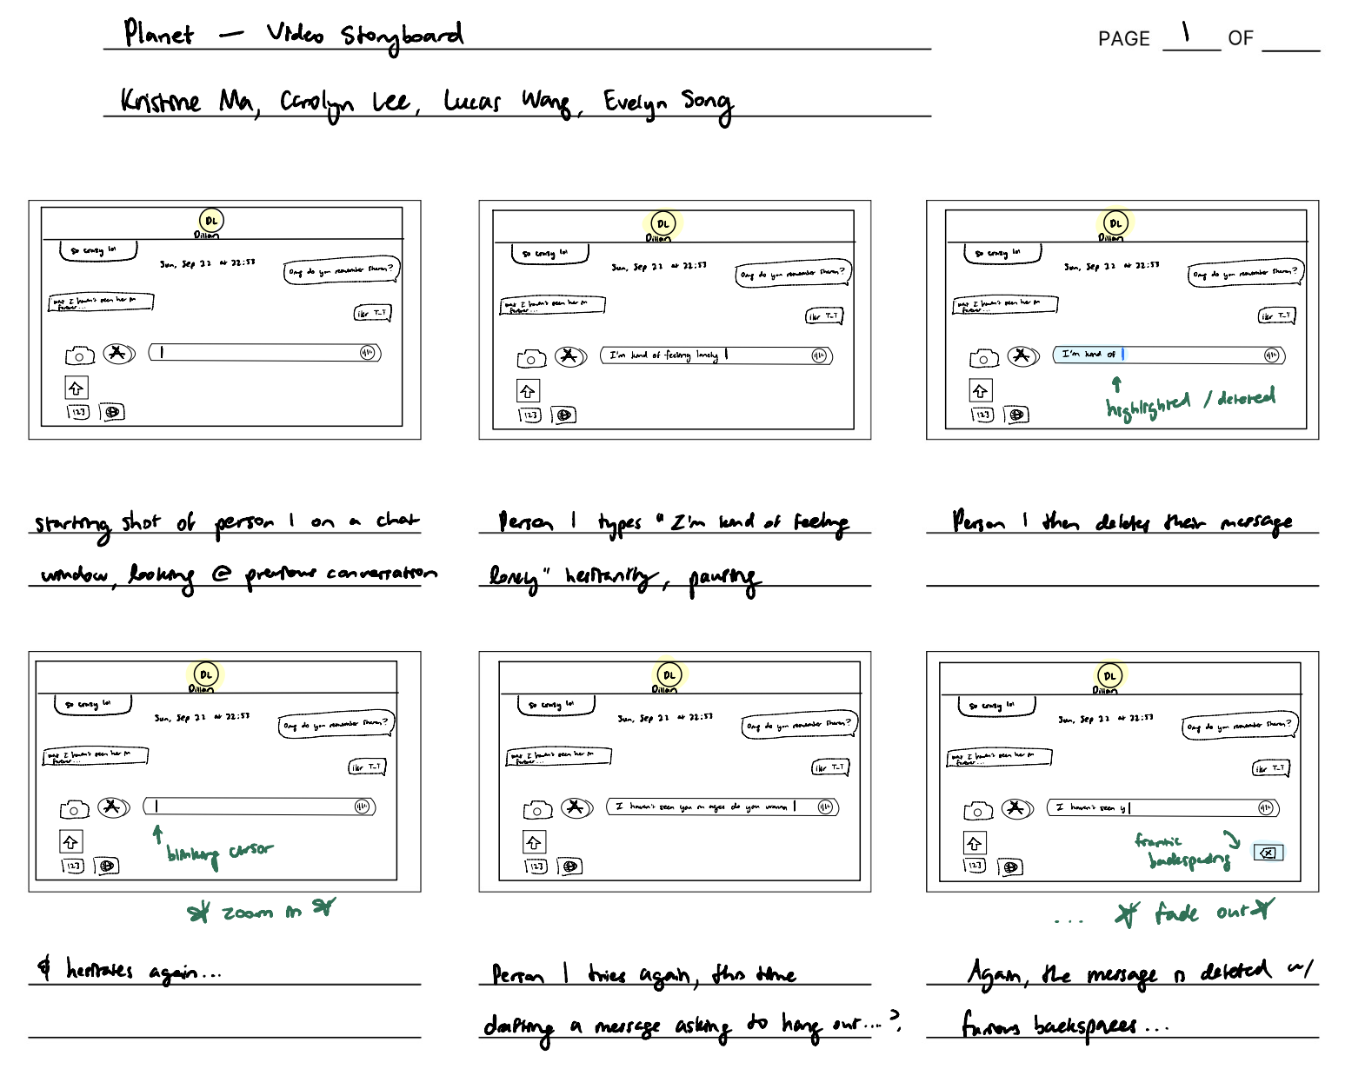
Storyboard

Slide 22
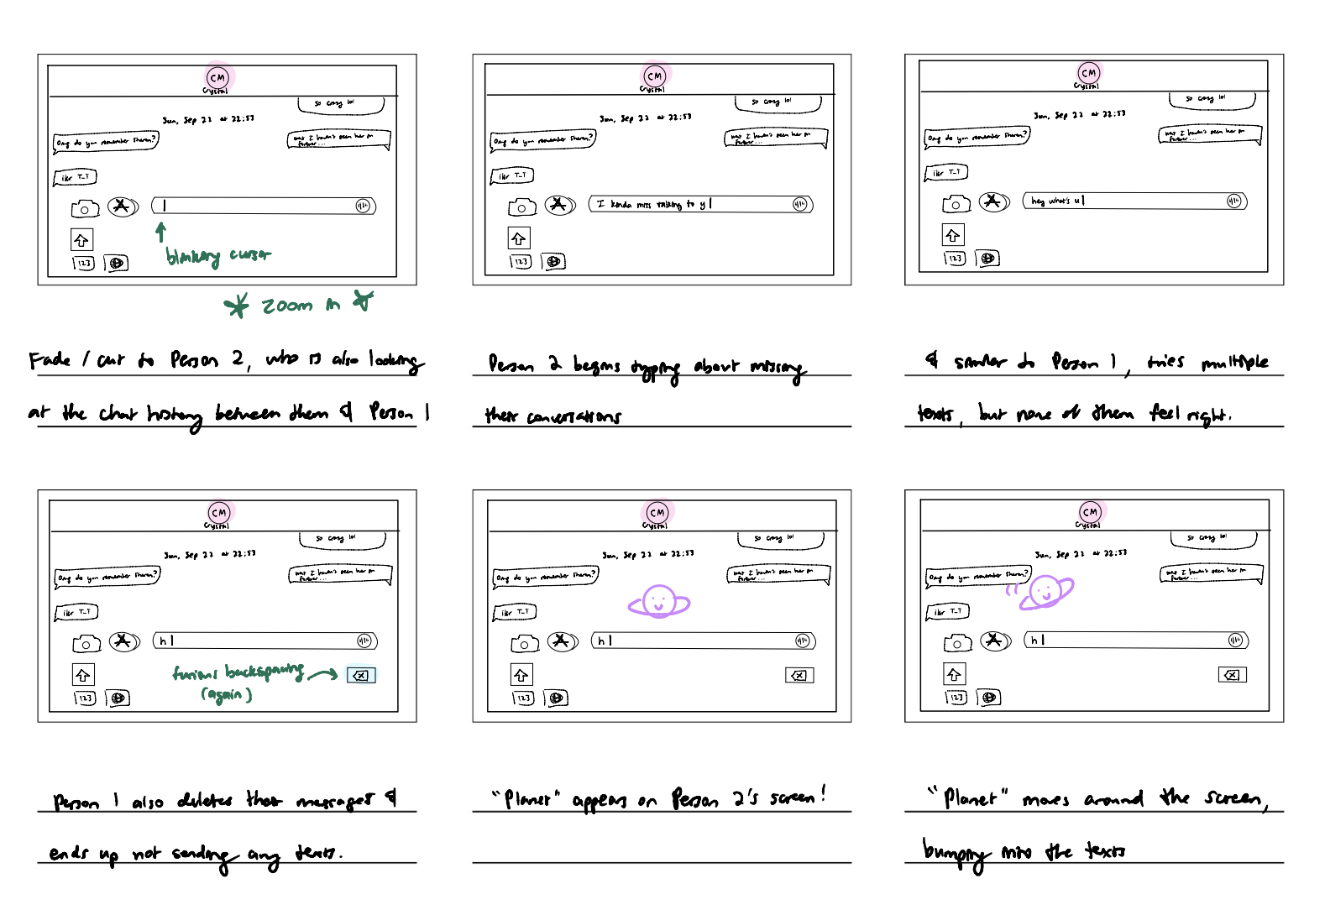

Slide 23
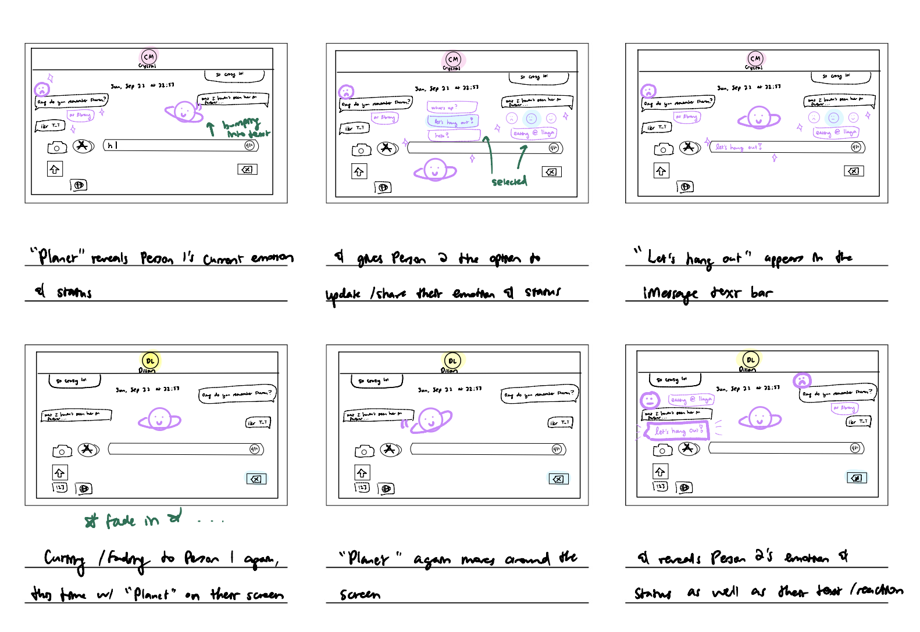

Slide 24
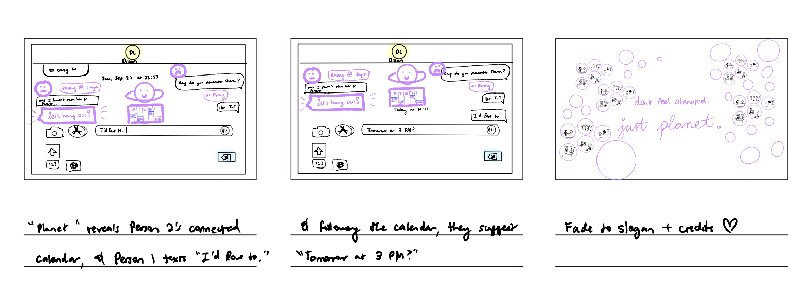

Slide 25
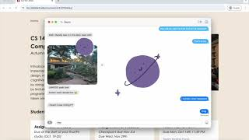
Concept Video
https://youtu.be/-F-jwwRCpN4

